Slide 1

Case Study 2: Katerra
By George Redden

Slide 2

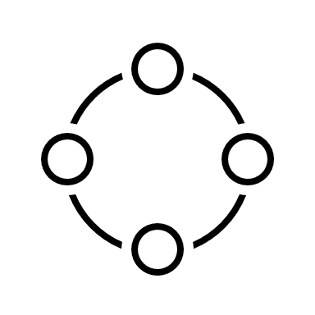
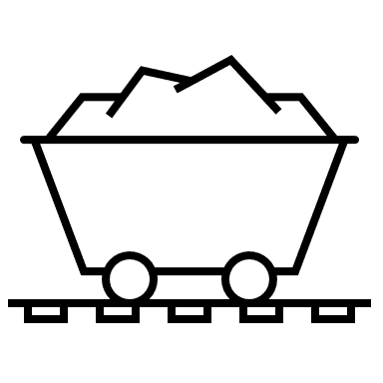

The market opportunity for Katerra is clearly very large. What do you think are the risks of this plan? How would you advise Michael to mitigate these risks? (hint: by market opportunity we are referring to the business opportunity, not the acquisition opportunity)
Taking a look at Katerra’s business model, one risk that immediately stands out is the ambition of the company to not only innovate at every stage of the value creation of the company, but also to specialize in every stage of the construction process. In other words, the company is seeking from the beginning to create a one-top shop for construction projects, vertically integrating every step of the value chain of an extremely complex industry. This strategy could lead to over-spending in the short-term while the company seeks to hone their processes and encountering liquidity issues during the J-curve period of the company.
In addition, there’s the risk of lack of focus. One key factor to consider for new companies is their ability to achieve product-market fit. Having a specific issue to focus on to provide value to customers increases the chances for startups to succeed. Although the company’s founder, Michael Marks, points out some potential incongruities and process needs that exist in the construction market, he fails to realize that the construction business deals with project processes by nature, which take longer to complete, work with highly customized products and have ill-defined subprocesses. Thus, achieving such a level of innovation that will transform the industry’s processes will be a tall order for the company.
Develop a cutting-edge ERP system
Integrate all stages of development into a factory model
Obtain better sourcing from suppliers by buying in bulk
Improve hiring practices
Katerra’s value proposition:
Katerra has established its own ERP company in India to manage the company’s business processes. This ERP could potentially provide 10 different products for other companies. However, it would face strong competition from both established players like Oracle and new more-affordable ones like Holded.
Katerra’s main objective is to integrate the financial area of construction with the development one. By vertically integrating every step of the construction value chain, Katerra can automate processes, speed up the completion and reduce sourcing costs by buying in bulk.
A key objective for Katerra is to save on supplier costs by buying large quantities of fixtures and materials for their projects. In short, Katerra plans to disrupt the market by transforming the construction sector from project processes to mass processes whereby the same materials can be used for different projects.
By moving most of the construction process into a factory, the company could have access to a bigger pool of employees since no experience would be required for the jobs available. However, this would force Katerra to develop a comprehensive training program.

Slide 3
How to mitigate the company’s risks
Having looked at Katerra’s different strategies to create value, it is clear that each objective could be enough of a challenge to found a separate startup. Moreover, it would require massive amounts of cash to survive the J-curve period and deal with any potential disruptions or setbacks during its development stage. Although the idea started with the goal of building cheaper, faster and better, it eventually became a massive endeavor to not only transform how construction projects work, but also its hiring process, ERP systems and the energy efficiency of its buildings. As a result, to mitigate the risks of failure, Katerra should consider the following recommendations:
How to mitigate the company’s risks
Understand the complexity of the industry and focus on one key area at a time. | One of the solutions provided by Katerra was to develop turnkey residential projects and save costs by integrating the 5 areas of the process. However, this would be an extremely difficult goal to achieve in the residential market as most customers prefer customization and many countries have very specific building codes that would pose a logistic challenge to Katerra. Turnkey projects are generally exclusive to bigger project finance developments in the industrial and commercial sectors. As such, prefabricated materials with fixed specs work better for these types of endeavors. A seasoned expert in construction will understand that a prefabricated wall for a 2-storey building would not work for a 5-storey commercial building. In short, a one size-fits-for-all approach in this industry would require the company to first change people’s attitudes and gain the support of regulatory agencies, something that can be very expensive and time-consuming.
Use its partnership with Wolff construction to gain expertise. | Although Katerra has a clear vision of how it would like to revolutionize the market, not every step has to be achieved at the same time. Instead, the company should take advantage of its partnership with Wolff Construction to gain experience and expertise in the sector while testing each of its innovations steadily. That way, the company can increase its probabilities of gaining a sustainble path to profitability while establishing a reputation that would convince contractors to work with the company.
The core business of the company is construction, not ERP or IoT systems. | Becoming a one-stop-shop for construction while developing an ERP for the industry at the same time sounds like a recipe for disaster. Seeking to gain a competitive advantage in both sectors simultaneously can result in the company losing focus and achieving innovation in none of these sectors. As a result, Katerra should first focus on improving its construction processes first. Vertically integrating every aspect of the value chain to carry out massive development projects does not seem feasible in the short-term. Instead, Katerra could first implement ERP solutions to improve payroll and tracking of financials, which would lead to higher savings in months not years. (Kunthara 2021)
Avoid blitzcaling before path to profitability is proven. | Unlike many tech startups like Uber that are asset-light in their operations, Katerra must carry inventory and other fixed costs that increase the risk of failure for the company should there be a major disruption in the market. Therefore, Katerra should avoid expanding its operations to many different areas until its business model proves to be sustainable. In short, the company should give itself enough leverage to extend its runway as much as posible since cash safety is essential in the construction sector and Katerra has high R&D costs.

Slide 4
Michael asserts that other general contractors cannot compete. Do you agree or disagree? Why? Are there any barriers to entry here? If so, what?
I agree to a certain extent. Looking at the data provided in the case study showing the top 30 global contractors, it becomes obvious that Chinese companies hold a significant control of the market. Similar to the solar panel industry, this makes it extremely difficult for Western companies like Katerra to compete because they don’t have access to the same labor costs and government support that the CCP offers to these companies. Furthermore, with the current multi-polarization of the world, Chinese firms have been able to forge strong partnerships across emerging economies, in particular, in the African continent. Therefore, to become a global contractor, there are significant barriers of entry that must be meet.
However, that does not mean that contractors cannot compete. There are still plenty of opportunities for contractors on a smaller scale to be disruptive and offer competitive offers in local or niche markets. In particular, with the revolution of energy saving batteries, new developers are integrating these technologies in their designs.
Barriers to overcome in the construction industry as a global contractor
Capital intensity
Geopolitical Barriers
Supply Chain logistics
Cyclical nature of the business
Unions and Labor costs
The main barrier to become a global contractor is the capital intensity nature of the business.
High fixed costs from equipment, inventory require access to high capital financing.
Meeting the safety and environment regulations of different regions requires companies to incur in diligence, training, and equipment costs. Also, the political risk for certain countries can lead to higher interest rates and insurance fees.
Being able to meet the supply resources of a project in a timely manner require the company to have a sophisticated ERP system. Also, the price of raw materials can wildly fluctuate in a short-period of time, which results in quotes for projects being inaccurate. This requires the company to have significant cash reserves.
During recessions, market disruptions or periods of high interest rates, the construction sector suffers considerably and demand for new projects slows down. Thus, many contractors are not able to find investors to continue financing their activities, which is what eventually happened to Katerra.
In certain markets like in the US, the trades and construction labor pool is highly unionized. As a result, contractors do not have ample flexibility to negotiate lower wages or demand employees to work overtime if projects become delayed. This generally results in costs overruns .

Slide 5
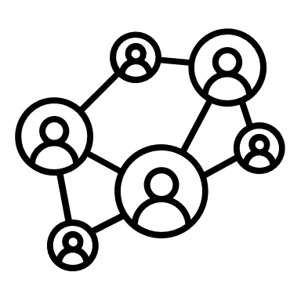

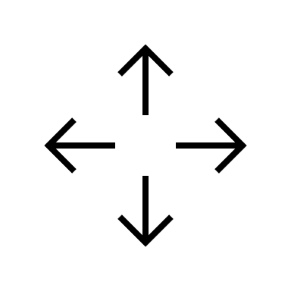


Why were general contractors and subcontractors not motivated by Katerra’s initial value proposition of providing lower-priced construction materials and supplies?
There are several factors that hindered Katerra’s ability to provide low-priced construction materials to contractors and subcontractors.
Construction is a tightly-knit industry
Construction tends to be a project process (high customization)
Risk of losing partnership
Fear of disruptive change
In the construction sector having a familiar, reliable and trustworthy partner is often more important than getting cheaper products from a newcomer enterprise. Katerra cannot expect to break long-established partnerships without having a proven record of success as contractors are risk averse.
As mentioned before, different commercial and residential projects will require customized materials. This is not an environment conducive for prefabricated materials as contractors prefer flexibility and the ability to meet the customers demands even if it comes at a higher price.
Contractors would have assessed that the financial risk of switching their supplier would be too high since Katerra did not have an established path to profitability. Thus, it was highly dependent on investor financing. Given the risk or startup failure, a savvy contractor would not risk losing a reliable partner for a risky startup.
Another possible factor could have been the contractors lack of understanding or fear of its disruptive business model. Like many tech startups, Katerra had to convince contractors that this new model was more efficient than the previous one and it was going to disrupt the market.
It is worth noting that Katerra was a newcomer in the construction material and supply market. As explained in the case study, this is a mature market with large companies like Home Depot, Ikea and Leroy Merlin and others that have a more robust supply chain market. (Stanford 2019) Contractors may have preferred to source from these companies as they are on-stop-shops for supplies, thus eliminating complexity in their supply chain. As explained before, Katerra had perhaps an over-ambitious plan that would have required unrealistic amounts of investments to become competitive in so many different sectors.

Slide 6
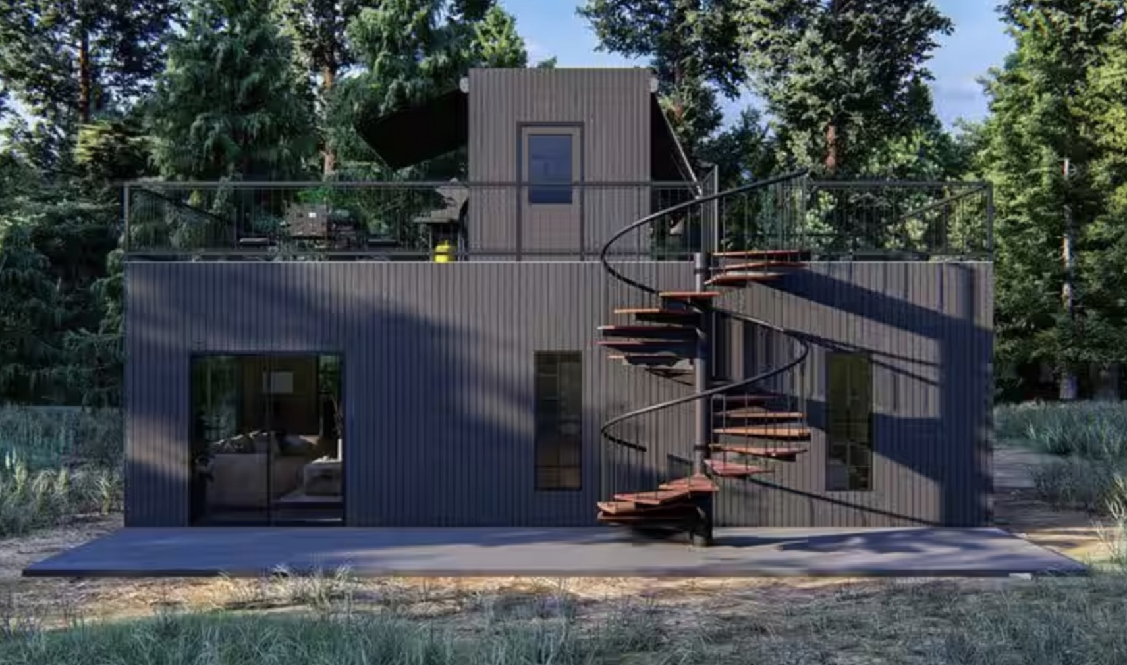
Michael asserts that Home Depot and IKEA have much greater buying power. Do you think that either of them would consider entering this business? What would be their considerations?
While it is true that Home Depot and Ikea have much greater buying power, as can be seen from this case study, the construction industry is quite complex and requires more than having access to affordable supplies to succeed. The supply chain is just a part in the value chain that can provide a firm a competitive advantage, but not overall profits. In fact, large enterprises like Home Depot and even Tesla have already had forays into the construction business with very mixed results. In the case of Home Depot, they have recently begun selling prefabricated homes, focusing on customers with DIY skills. As a result, it is a fact that these companies have considered entering this business. The main difference is that their aspirations have been much more modest. Unlike Katerra, Home Depot is only offering a very segmented product that would only cater to a small niche market. This makes sense as the company’s main value proposition is its ability to offer affordable modular homes using its leverage to obtain cheap materials. In other words, their homes work in a similar way to their shelf kits. This is far from the turnkey units offered by Katerra and require much less amount of logistics to build. Therefore, Home Depot is more interested in expanding its offerings in the adjacent industry or DIY rather than fully committing its resources to become a construction developer, much less integrating all the areas of the construction sector. For this to occur, the company would have to change its business model and most likely, create an entirely new subsidiary.
Things to consider:
Before entering the market, these companies would most likely develop a business model canvas to collect all the necessary information about the business. For instance, the customer segments (residential, commercial…) that the company would cater to. The key activities that the company would focus on and the channels to source materials from. However, these are some examples of key factors to consider:
Customer Segment
Revenue Streams
Key resources
Channels
Residential or commercial?
Prefabricated homes, ERP systems, supply chains…
Strong brand, DIY expertise, robust supply chain.
Online, direct shop sales.
Example of a Home Depot prefabricated home
Source: https://nypost.com/2023/06/02/would-you-pay-43k-for-this-home-depot-tiny-house/

Slide 7


Should Michael accept the $15 billion buyout offer?
Although, at the time, this question would have been difficult to answer given the fact that Katerra had become one of the most funded VC companies with multiple successful rounds under its belt (in 2018, series D reached $1Bn) there were clear signs that the company’s directors were not up to the task to achieve their goals. For starters, Michael Marks, whose background was in the tech sector as CEO of Flextronics, did not possess the necessary knowledge to understand why it was so difficult for the construction sector to move from a project process to batch or even mass process. This led to the company quickly losing its focus, trying to become a market leader in at least 4 different areas of the construction value chain. This would have been a nearly impossible task for a highly experienced CEO in the construction business, let alone one with no experience at all. For this reason, it would have been a good idea to either sell the company to a leading developer or at least seek the opportunity of building an alliance to reduce entry barriers.
In hindsight, after the company went bankrupt in early 2021, revelations came from insiders of how chaotic were its operations during its expansion period. According to reports, the company was plagued by cancelled projects, accidents in its factories, and inability to offer lower prices. (Pitchbook 2021) Moreover, employees were often frustrated by the management director’s ill-informed comparisons that the construction system could work just like the tech industry. (Constructiondive 2022) This shows that the directors of the company did not have the necessary expertise to achieve the company’s objectives. As pressure from each new round of funding increased, the company switched strategies by going on an acquisition spree, trying in vain to establish itself as a major player in the market. (Pitchbook 2021)
Perhaps with the expertise of a leader developer the company would have been able to remain afloat during the pandemic. However, what is clear is that the industry was not ready for such a drastic overhaul as no other company has tried to replicate Katerra ever since. The silver lining from this case is that Katerra pioneered the market for prefabricated modular units as several other companies have entered the market offering affordable options to those looking for cheaper housing alternatives.
Reasons for selling | Reasons against selling
Lack of expertise in the sector. Company is not well-established enough to overcome entry barriers. The company has not found a viable path to profitability. The company could gain focus and meet its objective of solving the housing crisis. The company has experienced a series of setbacks indicating that it may not be up to the task. | The company is growing and has been successful at finding investors. The company may lose its original purpose.

Slide 8
The company’s legacy: Lessons learned.
Even though Katerra’s business model proved to be over-ambitious, it opened the doors for startups to introduce innovations in the construction sector. While a key take-away from this case study is that residential construction developments are far from the batch or mass processes found in the tech industry, perhaps there is a market for a more focused and segemented business venture. Among the opportunities created by Katerra are the following:
There is now a market for prefabricated modular homes.
New startups have focused on improving ERP systems in the construction sector. For example, Extracker (now Clearstory), a startup founded in 2018 digitizes orders and helps companies keep track of costs. (Kunthara 2021)
Giant retailers like Home Depot and Ikea have begun to offer prefabricated supplies and materials to facilitate the construction process.
Final thoughts: Perhaps following the production model of companies like Jaguar and Rolls Royce is the key.
Jaguar’s supply chain strategy called Nirvana to build its X-400 model perhaps offers a better business model for future construction companies seeking to integrate all aspects of the value chain into a factory. Jaguar’s factory in Halewood was completely transformed to build highly customizable cars with very little to no surplus inventory. Thus, the company successfully transformed the mass process of building cars to something more similar to a project process. This model of production was later adopted by Rolls Royce, which made the process even more customizable.

Slide 9
References
Stanford University. 2019. Katerra. https://services.hbsp.harvard.edu/api/courses/1118688/items/E655-PDF-ENG/sclinks/b30baac1a5f9d4d01ca4e82d6c320263
Pitchbook. 2021. “Katerra's downfall reminds us that it's (still) time to build.” https://finance.yahoo.com/news/katerras-downfall-reminds-us-still-050000058.html
Constructiondive. 2022. https://www.constructiondive.com/news/what-does-katerras-demise-mean-for-the-contech-and-modular-industries/608037/
Kunthara Sohpia. 2021. “What Katerra’s Collapse Means For Construction Tech Investment.” https://news.crunchbase.com/venture/katerra-construction-tech-startups-vc-investment/

